Slide 1

SAMS
Students’ Auditorium Management System
Team 23
Monal Prasad
Aditi Mishra
Yash Agarwal

Slide 2
OVERVIEW OF THE PROBLEM
Our software enables a convenient way to book, manage and administer a Students’ Auditorium which conducts various types of social and cultural events.
Users
Manager has the utmost authority over every show - its timing, seating and pricing
Show Manager
Audit Clerk
1
2
Audit Clerks handle the accounting tasks for the auditorium
Salespersons can search for shows, book seats and print tickets from a Graphical UI
3
Sales Person
Spectator
Spectators can search for a show and look at it’s seat occupancy details from a Graphical UI
4

Slide 3
Salient Features
Interactive GUI
Easy Booking /Cancelling of seats
Maintains a database for all previous transactions
Easy handling for show manager
Graphical interface to view seat availability

Slide 4
IMPORTANCE
Competition
Almost every successful business in the world has a digital presence. It’s very important in today’s world to keep up the pace to survive in the competition.
Convenience
Consolidated information about all bookings, availabilities and various other details about the auditoriums.

Slide 5
CHALLENGES FACED
Distortion in Styling during integration of calendars
Importing old information from the database into the system using the csv package in python
Handling datetime objects in python and conversion to user understandable outputs
Designing a database system to conveniently read and write auditorium specific information

Slide 6
LANGUAGES AND PACKAGES
Python
Python is used for its versatility, large number of packages
and its ease of implementation
TKinter
Tkinter is used to make a GUI and improve the end user’s overall experience by making it attractive and easy to use
CSV
CSV is used to read and write data from the various csv files that store the details about auditorium data like transactions, shows, seat availability, etc.

Slide 7
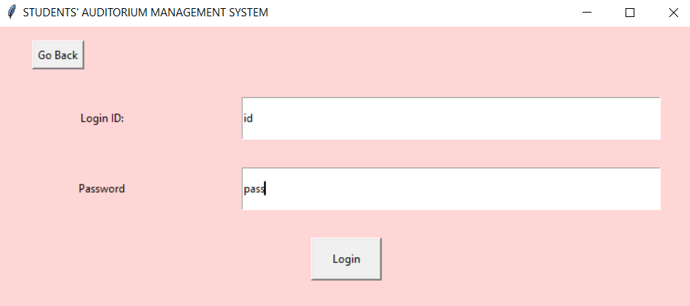
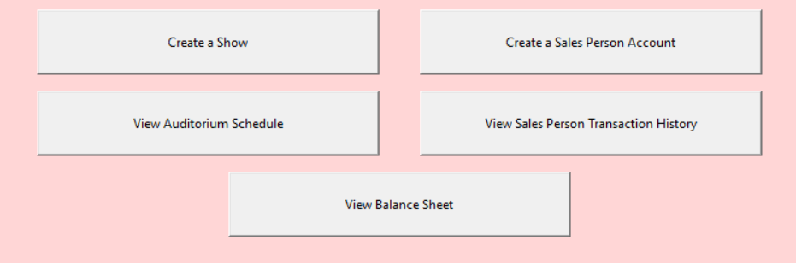
CHALLENGING USE CASES
Login Page
Employees can Log In according to the IDs assigned to them by the show manager
Show Manager Menu
Show manager gets various options to initialise the system and modify it as per requirements

Slide 8
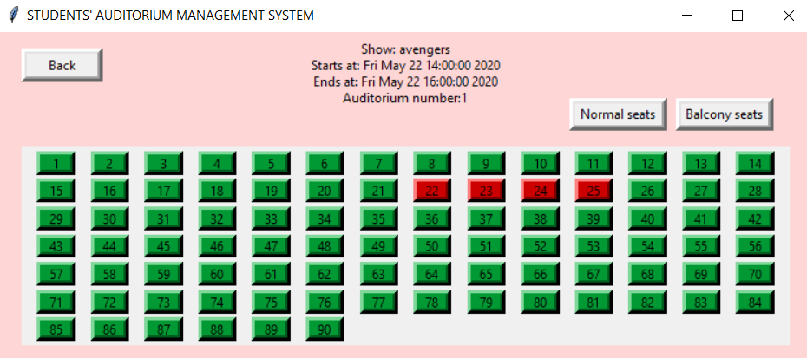
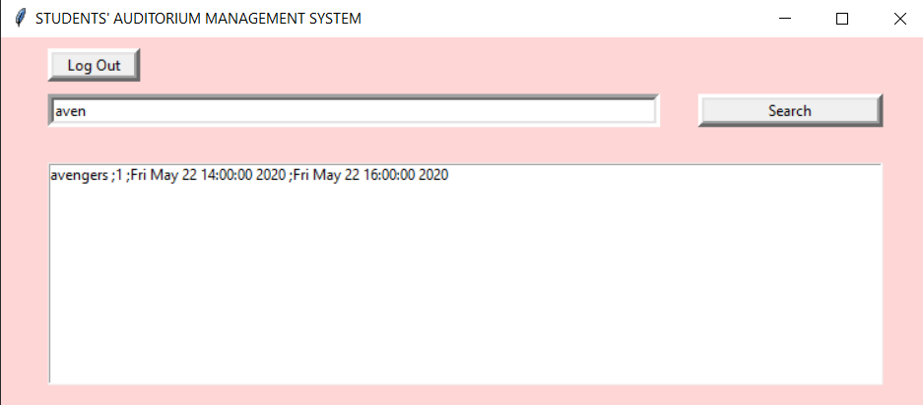
CHALLENGING USE CASES
Create bookings as a salespersons
Adding a transaction via salesperson and updating database
Search shows as a spectator
Find shows in the database using keywords

Slide 9
IMPROVEMENTS
Future Work
The following are some of the major improvements that can be done in future
Payment portal for spectator in the user interface itself
1
Hosting the entire system online for easy accessibility and increased security
2
More categories of seats can be added in the future
3

Slide 10

SOFTWARE DEMO

Slide 11
THANK YOU !

